Slide 1
Algorithmic Discrimination, Fair ML, and Responsible Data Science
Module 8 Live Session
IMT 575
Winter 2022

Slide 2
today
Discussion of Discrimination in ML
Lab 8 demo

Slide 3
Legal definitions of discrimination (1/3)
Title VII of Civil Rights Act 1964 prohibited intentional discrimination based on race, color, religion, sex (including sexual orientation and gender identity) or national origin.
But what if a company uses some screening process that discriminates implicitly?
Notes:
More formal definition; cite laws, 80% rule, statistical significance.

Slide 4
Legal definitions of discrimination (2/3)
Griggs v. Duke Power Co., 401 U.S. 424, 431-2 (1971).
Company originally had segregated work facilities
After Title VII passed, they added a requirement of a high school diploma or a minimum score on an IQ test for positions in areas other than the labor department.
The Court found that under Title VII, if tests disparately affect ethnic minority groups, employers must demonstrate that such tests are "reasonably related" to the job for which the tests are required.

Slide 5
Legal definitions of discrimination (3/3)
Disparate treatment is the illegal practice of treating an entity, such as a creditor or employee, differently based on a protected characteristic such as race, gender, age, religion, sexual orientation, or national origin.
Disparate impact is measures different outcomes based on class, regardless of the procedure used to produce those outcomes
about intent
about outcomes

Slide 6
1978: Uniform Guidelines: 80/20 rule
A four-step process determines adverse impact:
Calculate the rate of selection for each group (divide the number of persons selected from a group by the number of applicants from that group).
Determine which group has the highest selection rate. For positive personnel transactions, the highest rate is the most advantageous. For negative personnel transactions, the most favored group has the lowest rate.
Calculate the impact ratios by comparing the selection rate for each group with that of the highest group (divide the selection rate for a group by the selection rate for the highest group).
Observe whether the selection rate for any group is substantially less (i.e., usually less than four-fifths or 80 percent) than the selection rate for the highest group. If it is, adverse impact is indicated in most circumstances.

Slide 7
What about Machine LEarning?

Slide 8
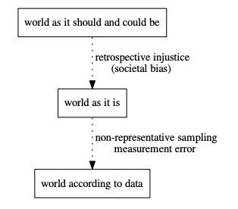
from “Prediction-Based Decisions and Fairness” by Mitchell, Potash and Barocas, 2018

Slide 9
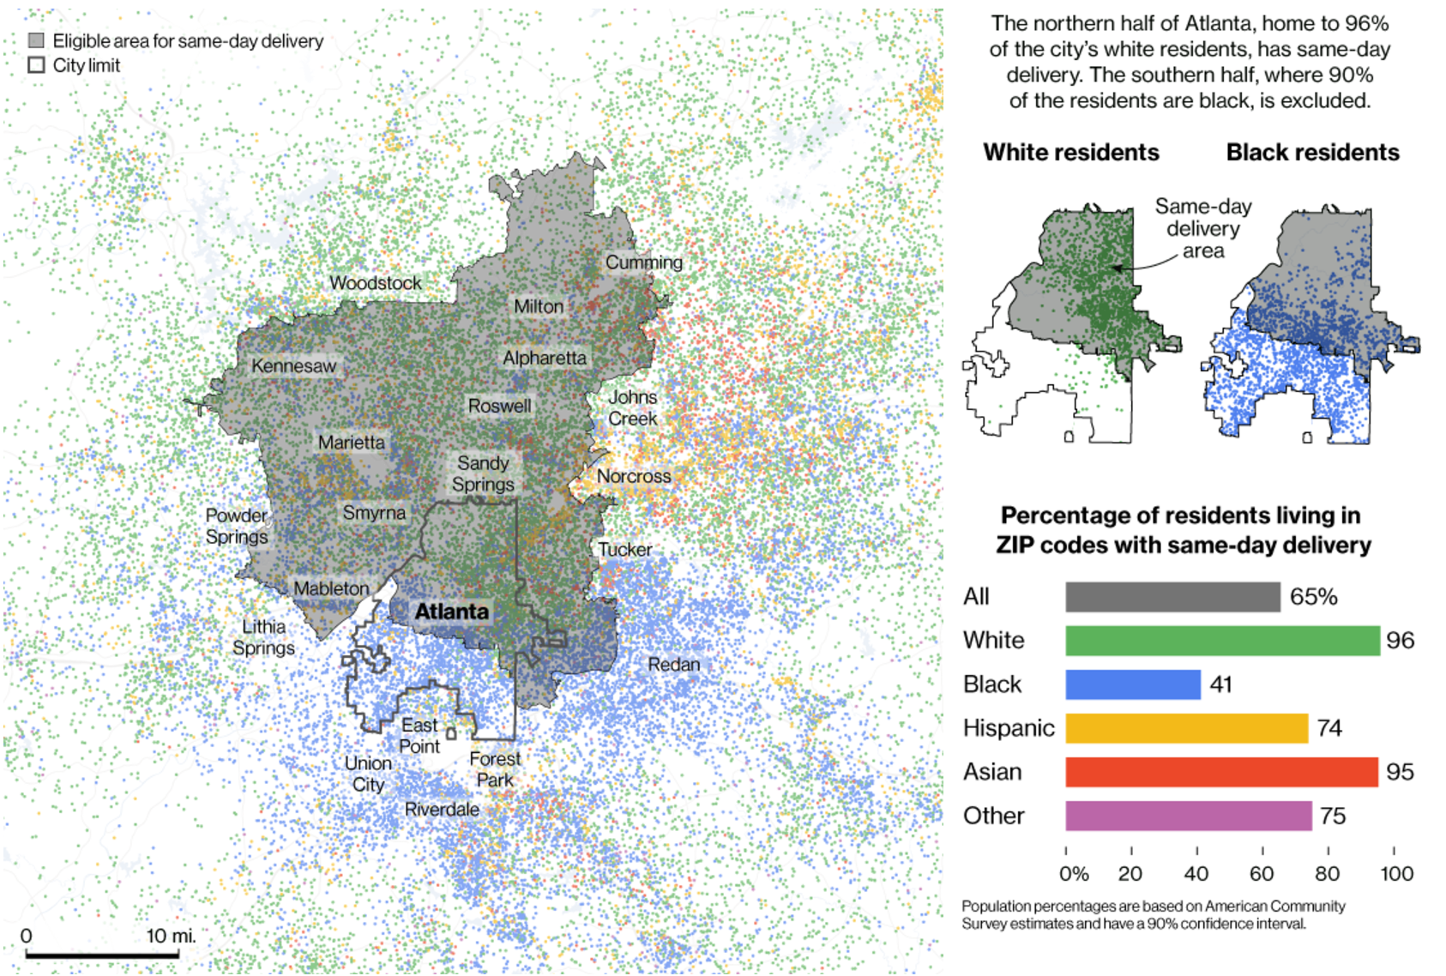
Amazon Prime Now Delivery Area: Atlanta
Bloomberg, 2016
Notes:
Let me give you an example.
Bloomberg wrote a piece in 2016 about the Amazon prime now delivery area. They trained a model to decide who to offer the service to, considering buying history, income, location. They did not consider race.
This is a map of Atlanta. I grew up in Atlanta. You can see that everyone in the north half received the discount and no one in the south half did. What else is true about the north half of Atlanta vs. the south half?

Slide 10
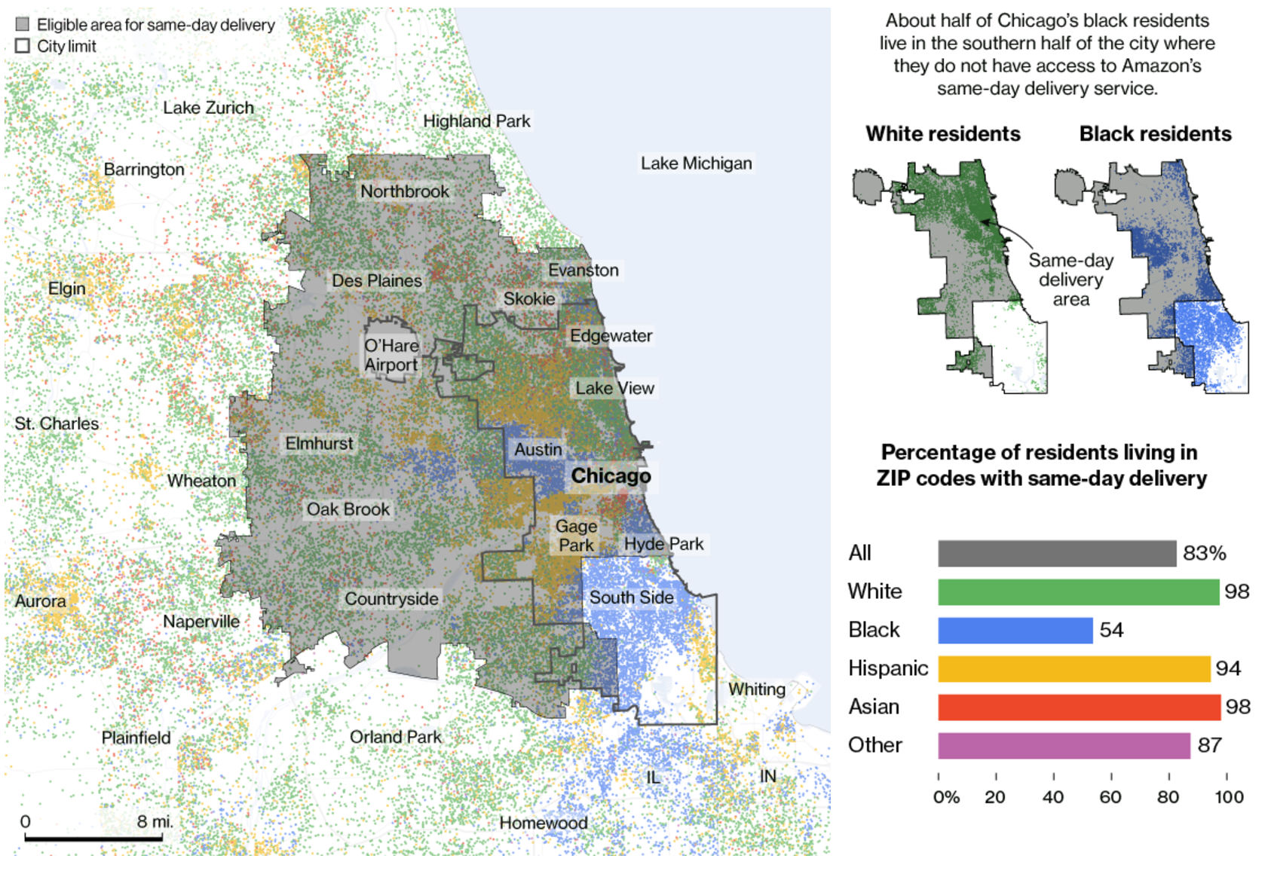
Amazon Prime Now Delivery Area: Chicago
Bloomberg, 2016
Notes:
It gets worse. In Chicago, everyone received the service except the south side, which is predominately African American.

Slide 11
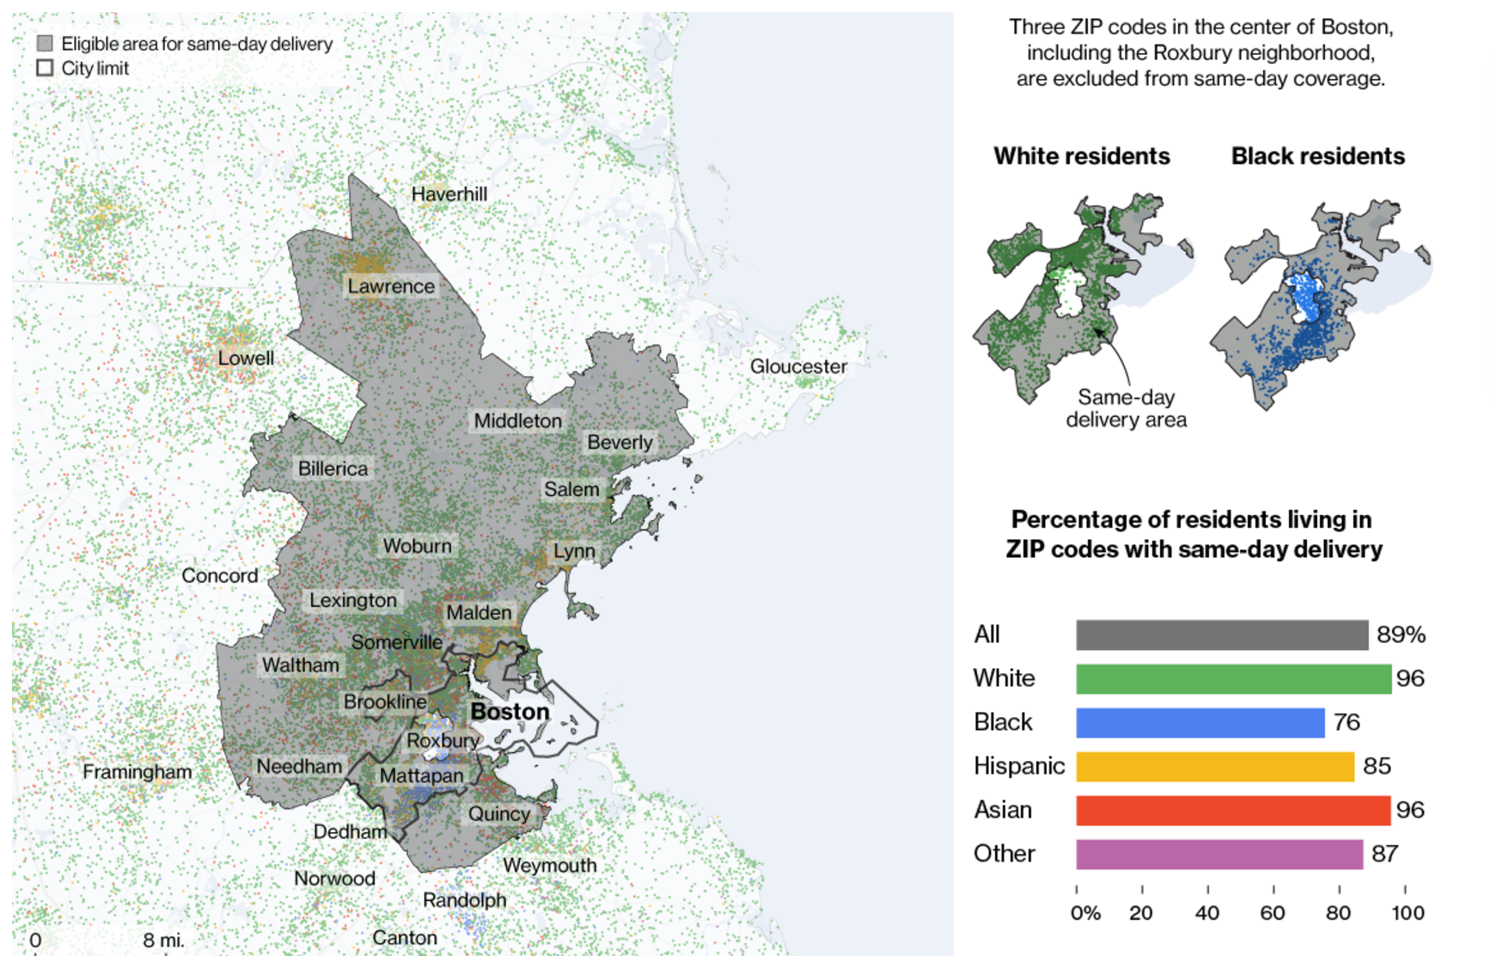
Amazon Prime Now Delivery Area: Boston
Bloomberg, 2016
Notes:
In Boston, they carved out a donut shape around Roxbury.
The HUD recently sued Facebook for this kind of digital redlining, and signaled that Twitter and Google are next.

Slide 12
redlining map of Atlanta, National Archives, 1938

Slide 13
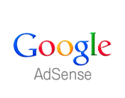
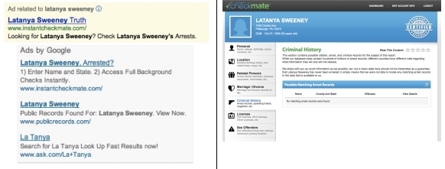
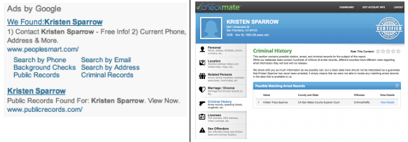
Racially identifying names trigger ads suggestive of an arrest record
[Latanya Sweeney; CACM 2013]
slide adapted from Stoyanovich, Miklau
Notes:
Users and regulators must be able to understand how raw data was selected, and what operations were performed during analysis
Users want to control what is recorded about them and how that information is used
Users must be able to access their own information and correct any errors (US Fair Credit Reporting Act)
Transparency facilitates accountability - verifying that a service performs as it should, and that data is used according to contract

Slide 14
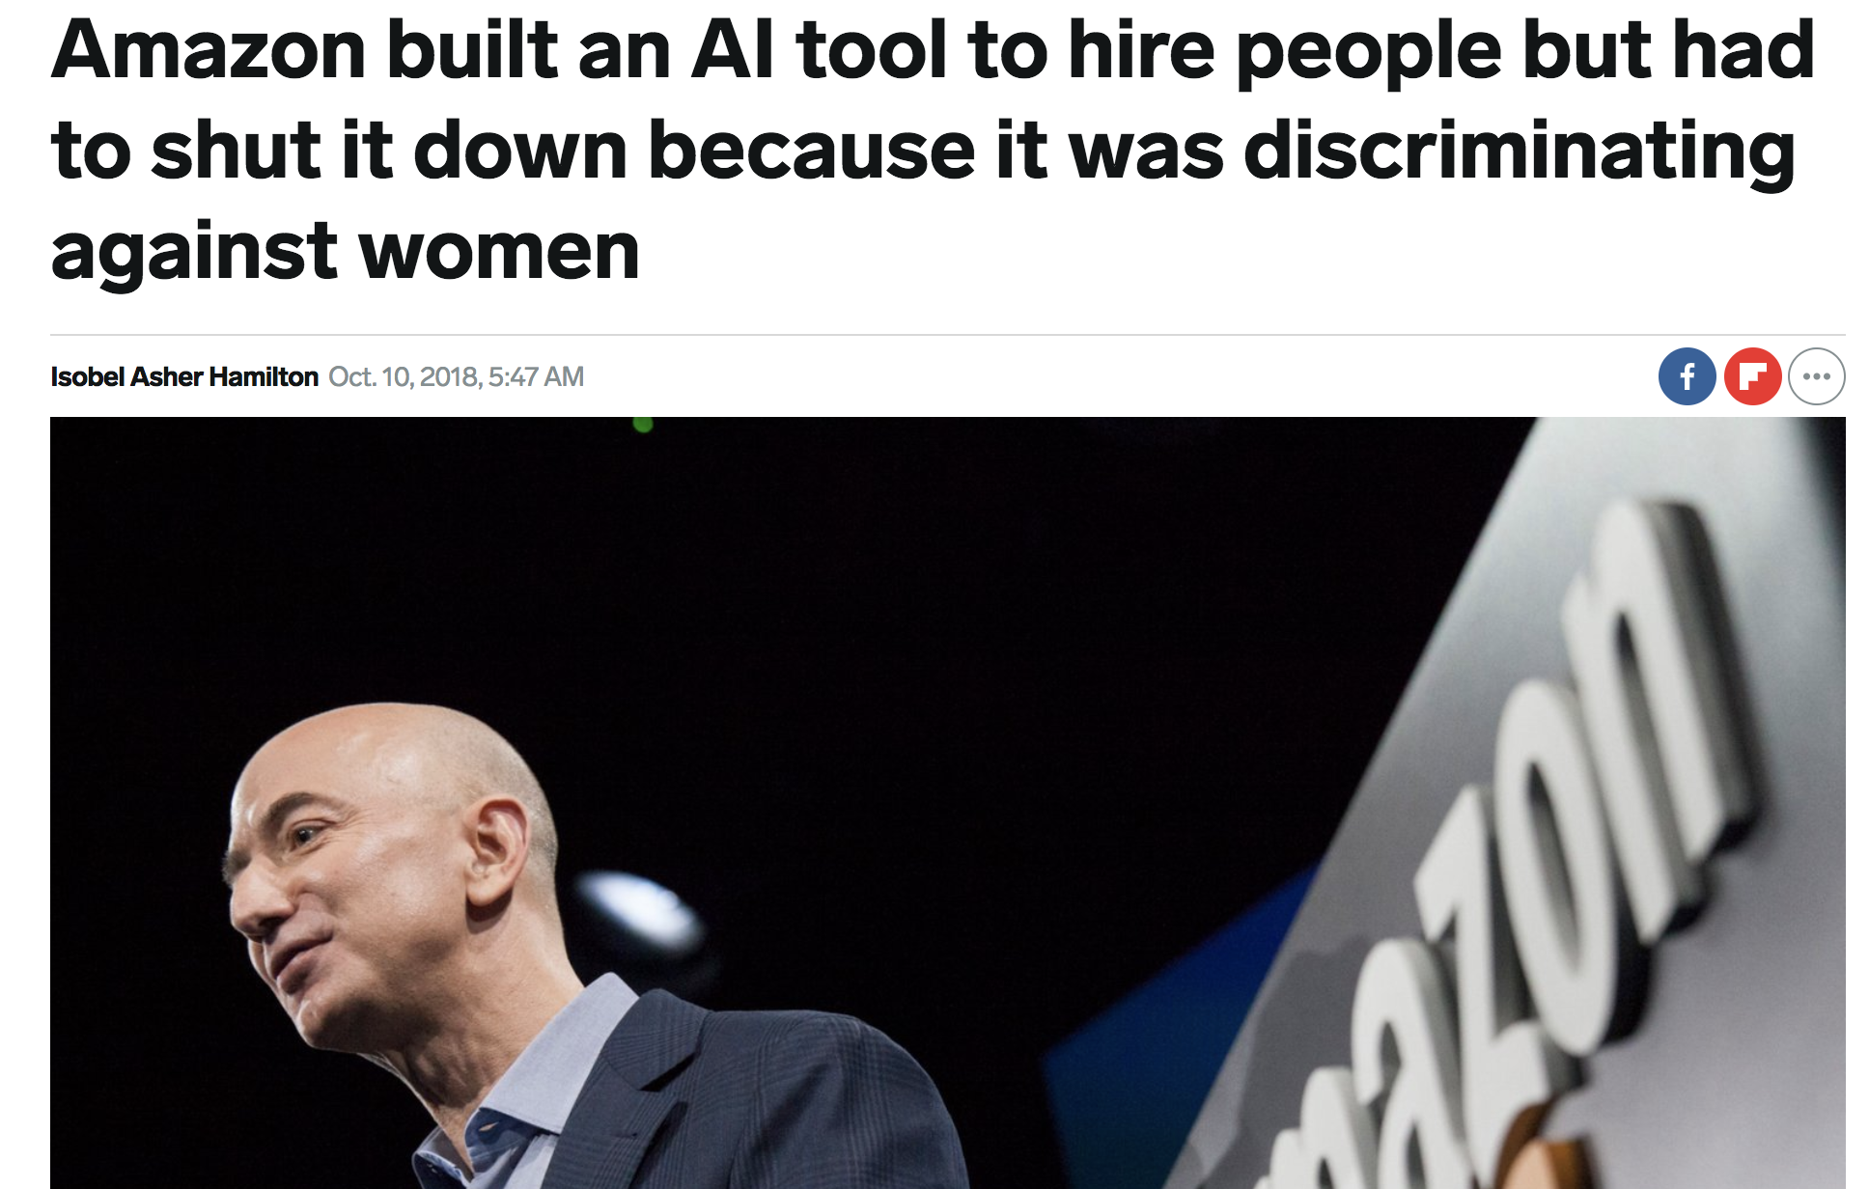

Slide 15
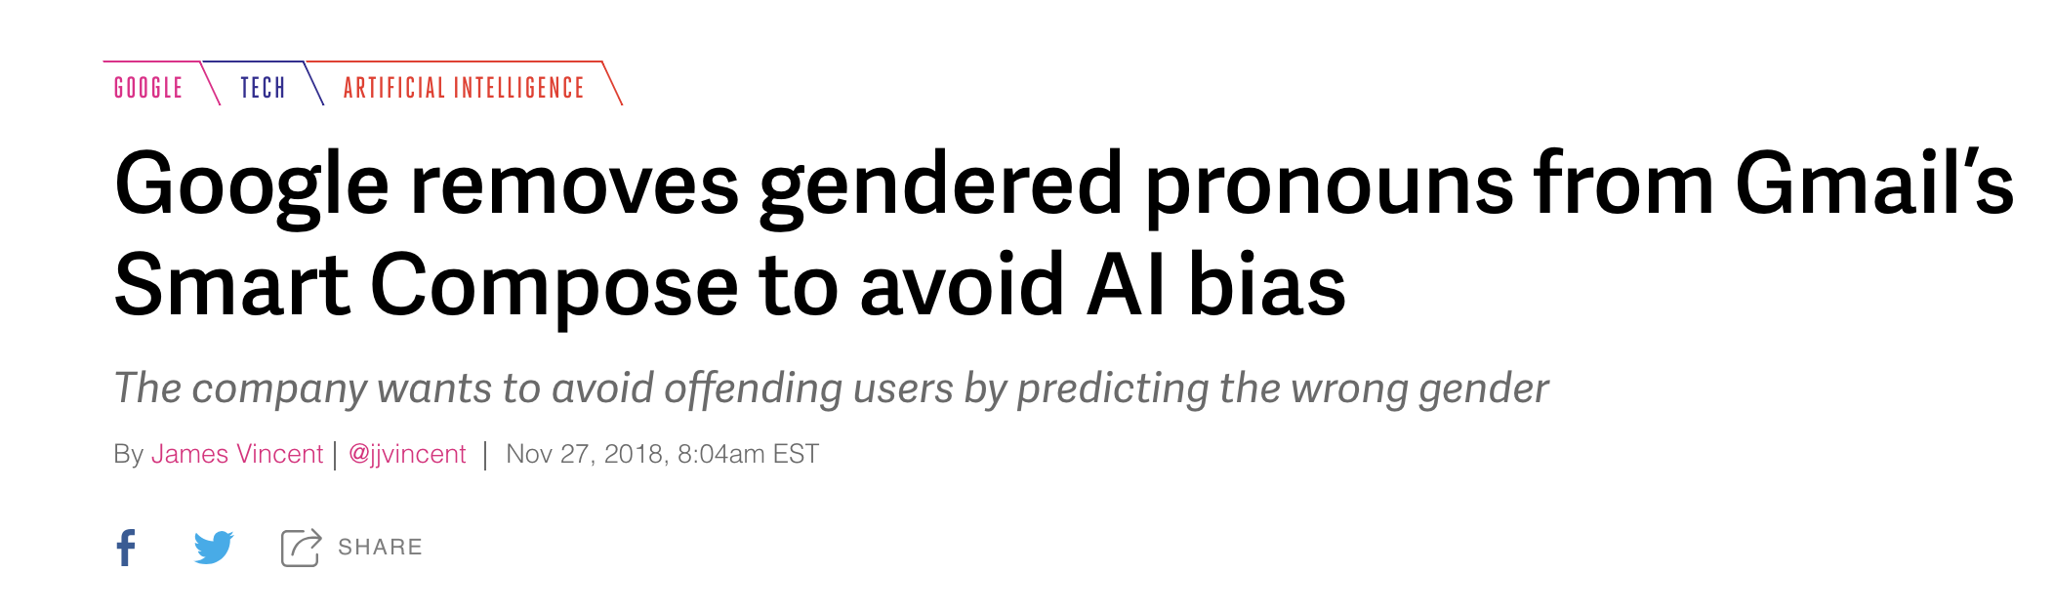

Slide 16
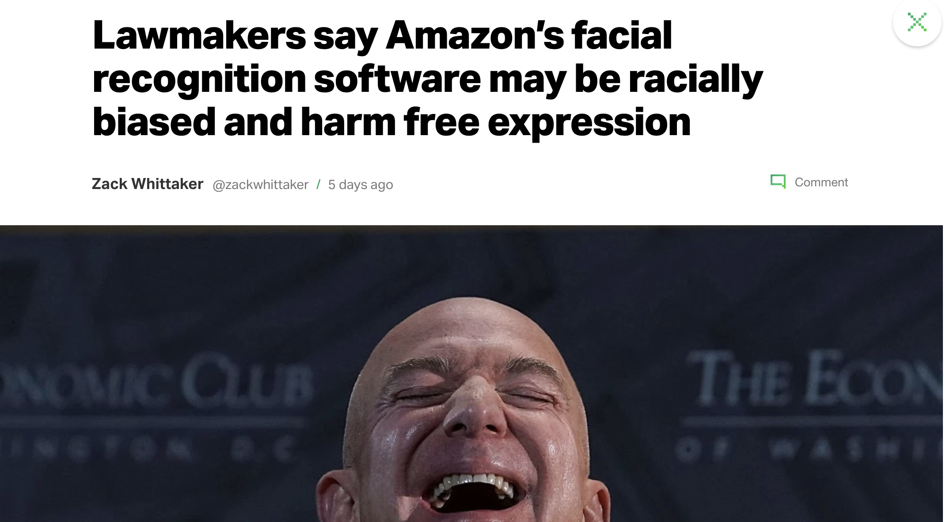

Slide 17
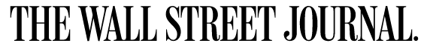
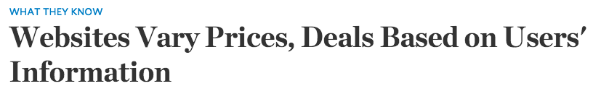
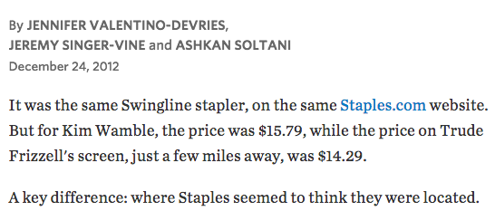
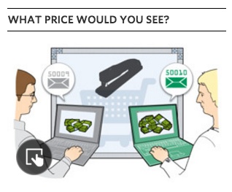
Ex: Staples online pricing
Reasoning: Offer deals to people that live near competitors’ stores
Effect: lower prices offered to buyers who live in more affluent neighborhoods
Notes:
From WLJ article:
A Wall Street Journal investigation found that the Staples Inc. website displays different prices to people after estimating their locations. More than that, Staples appeared to consider the person's distance from a rival brick-and-mortar store, either OfficeMax Inc. or Office Depot Inc. If rival stores were within 20 miles or so, Staples.com usually showed a discounted price.
In what appears to be an unintended side effect of Staples' pricing methods—likely a function of retail competition with its rivals—the Journal's testing also showed that areas that tended to see the discounted prices had a higher average income than areas that tended to see higher prices.

Slide 18
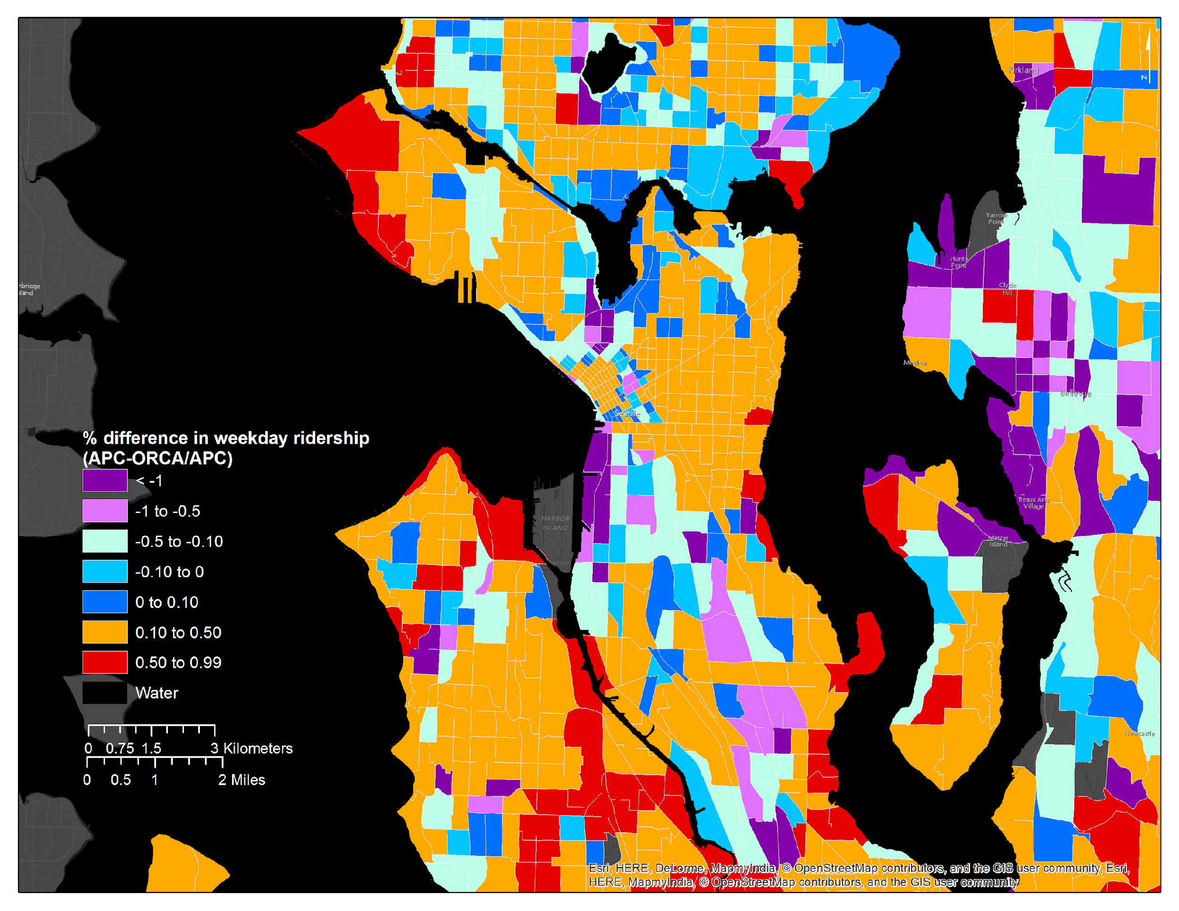

ORCA Percentage Difference in Ridership, Seattle
Mark Hallenbeck
TRAC

Slide 19
Google Translate swaps gender pronouns due to biased data
Notes:
Google’s language translation swaps pronouns for professions with historical gender bias

Slide 20
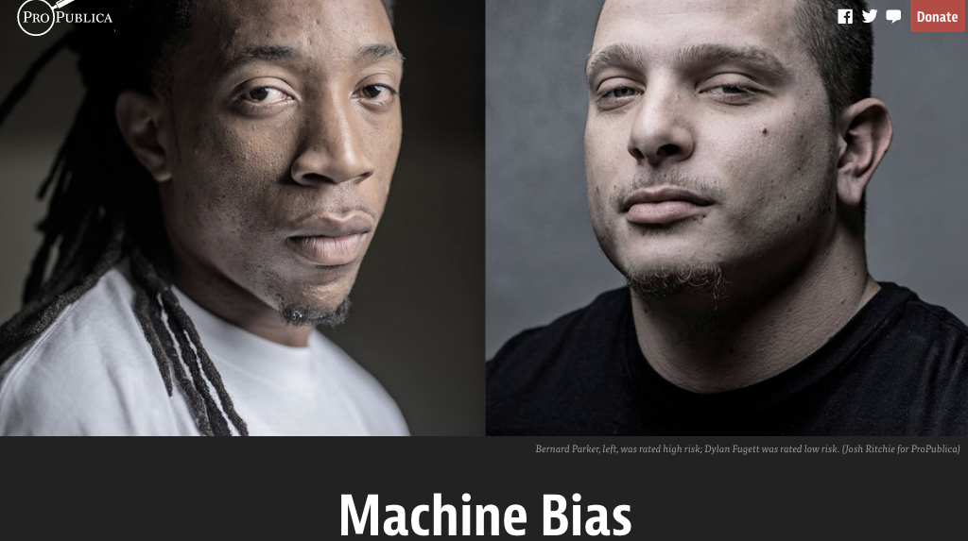
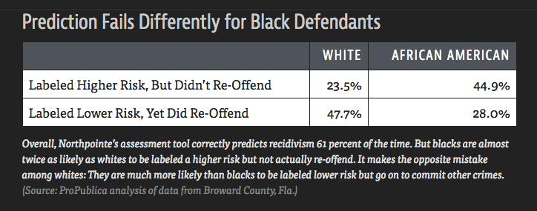
Propublica, May 2016

Slide 21
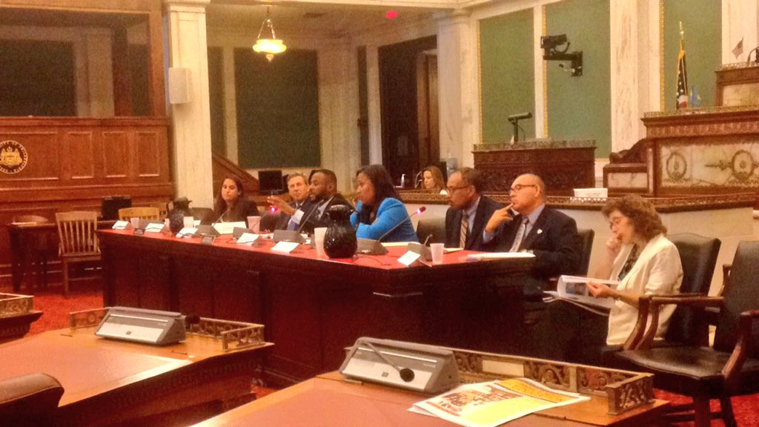
Philadelphia is grappling with the prospect of a racist computer algorithm
Technical.ly, September 2016
“Should I be afraid of risk assessment tools?”
“No, you gotta tell me a lot more about yourself.
At what age were you first arrested?
What is the date of your most recent crime?”
“And what’s the culture of policing in the neighborhood in which I grew up in?”
Any background signal in the data of institutional racism is
amplified by the algorithm
operationalized by the algorithm
legitimized by the algorithm
The Special Committee on Criminal Justice Reform's hearing of reducing the pre-trial jail population.
Notes:
LSI-R model
25 states use it
Most for targeted programs
Idaho and Colorado use this for sentencing
“As a Black male,” Cobb asked Penn statistician and resident expert Richard Berk, “should I be afraid of risk assessment tools?”
“No,” Berk said, without skipping a beat. “You gotta tell me a lot more about yourself. … At what age were you first arrested? What is the date of your most recent crime? What are you charged with?”
Cobb interjected: “And what’s the culture of policing in the neighborhood in which I grew up in?”
(emphasis mine)
That's exactly the point (and to Michael -- this is what I was arguing about with the guy from Comcast): a little bit of institutional racism has a triple effect:
a) institutional racism is amplified by the algorithm (a small signal can now dominate the model)
b) institutional racism is operationalized by the algorithm (it's far easier now to make impactful decisions based on bad data)
c) institutional racism is legitimized by the algorithm (so that everyone thinks "it's just data" and actively defends the algorithm's assumed objectivity, even when the racist results are staring you right in the face. This vigorous defense doesn't happen when a human is shown to be correlating their decisions perfectly with race.)

Slide 22
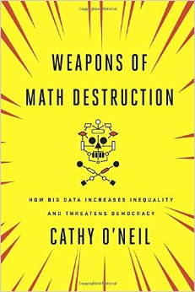

Cathy O’Neil
September 2016
Three properties of a WMD:
Opacity
Scale
Damage

Slide 23
Formalizing the Problem

Slide 24

Problem setup (1): Outcomes
Consider a vendor assigning positive or negative
outcomes to individuals.
Positive Outcomes | Negative Outcomes
offered employment | denied employment
accepted to school | rejected from school
offered a loan | denied a loan
offered a discount | not offered a discount
slide src: Julia Stoyanovich, Serge Abiteboul, Gerome Miklau

Slide 25
Problem setup (2): Assigning outcomes to populations
Fairness is concerned with how outcomes are assigned to a population
positive outcomes
40% of the population
◦
◦
◦
◦
◦
◦
⊕
⊕
⊖
◦
◦
◦
⊖
◦
⊖
◦
◦
⊖
◦
◦
⊕
◦
◦
⊕
◦
◦
⊖
◦
◦
⊖
Population
Assignments
Individual with
negative outcome
Individual with
positive outcome
slide src: Julia Stoyanovich, Serge Abiteboul, Gerome Miklau

Slide 26
Some notation for reasoning about fairness
O is predicted outcome, domain of {-, +}
e.g., loan application approved
Y is actual outcome, domain of {-, +}
S is a sensitive attribute, {m,M}
m=minority, M=majority
A is some other attribute

Slide 27
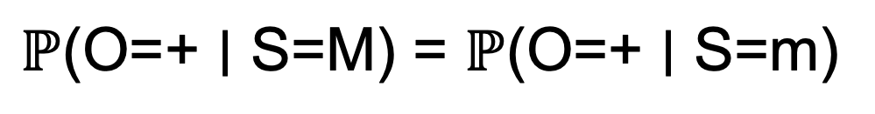
Demographic Parity (DP) a.k.a. Statistical Parity or Benchmarking
$$\text{ℙ}\text{(}\text{O}\text{=+ ∣ }\text{S}\text{=}\text{M}\text{)}\text{ = }\text{ℙ}\text{(}\text{O}\text{=+ ∣ }\text{S}\text{=}\text{m}\text{)}$$
O is predicted outcome, {-, +} (e.g., loan application approved)
Y is actual outcome, {-, +}
S is a sensitive attribute, {m,M}
A is some other attribute

Slide 28
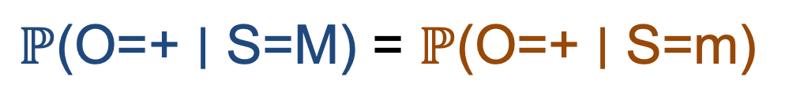
Demographic Parity (DP) a.k.a. Statistical Parity or Benchmarking
$$\text{ℙ}\text{(}\text{O}\text{=+ ∣ }\text{S}\text{=}\text{M}\text{)} \text{= }\text{ℙ}\text{(}\text{O}\text{=+ ∣ }\text{S}\text{=}\text{m}\text{)}$$
“The probability that the prediction is positive given that the individual is majority is equal to the probability that the prediction is positive given that the individual is minority.”
O is predicted outcome, {-, +} (e.g., loan application approved)
Y is actual outcome, {-, +}
S is a sensitive attribute, {m,M}
A is some other attribute

Slide 29
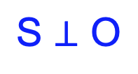
Demographic Parity (DP) a.k.a. Statistical Parity or Benchmarking
$$\text{ℙ}\text{(}\text{O}\text{=+ ∣ }\text{S}\text{=}\text{M}\text{)} \text{= }\text{ℙ}\text{(}\text{O}\text{=+ ∣ }\text{S}\text{=}\text{m}\text{)}$$
“The probability that the prediction is positive given that the individual is majority is equal to the probability that the prediction is positive given that the individual is minority.”
$$\text{S}\text{ ⊥ }\text{O}$$
“The sensitive attribute is statistically independent of the predictions”
O is predicted outcome, {-, +} (e.g., loan application approved)
Y is actual outcome, {-, +}
S is a sensitive attribute, {m,M}
A is some other attribute

Slide 30
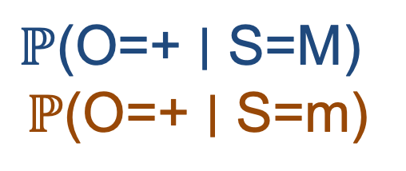
80/20 rule (1978 Uniform Guidelines)
$$\text{ℙ}\text{(}\text{O}\text{=+ ∣ }\text{S}\text{=}\text{M}\text{)}$$
$$\text{ℙ}\text{(}\text{O}\text{=+ ∣ }\text{S}\text{=}\text{m}\text{)}$$
<= 80%
“The ratio of the probability that the prediction is positive given that the individual is majority to the probability that the prediction is positive given that the individual is minority is less than 80%
O is predicted outcome, {-, +} (e.g., loan application approved)
Y is actual outcome, {-, +}
S is a sensitive attribute, {m,M}
A is some other attribute

Slide 31
Complaints about Demographic Parity
Doesn’t account for other qualifications
You could get statistically lucky or unlucky
Doesn’t hold institutions responsible for their applicant pool

Slide 32
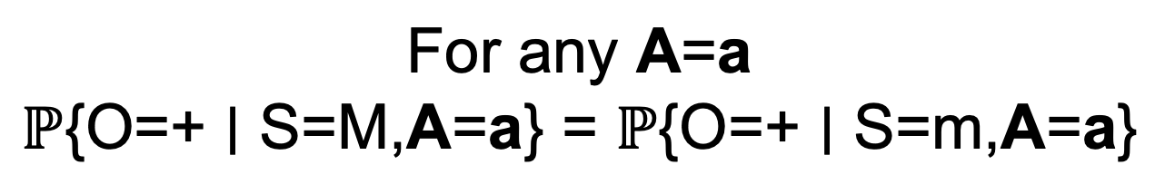
Conditional Statistical parity
$$\text{For} \text{any} \text{A}\text{=}\text{a}$$
$$\text{ℙ}\text{\{}\text{O}\text{=+ ∣ }\text{S}\text{=}\text{M}\text{,}\text{A}\text{=}\text{a}\text{\} = }\text{ℙ}\text{\{}\text{O}\text{=+ ∣ }\text{S}\text{=}\text{m}\text{,}\text{A}\text{=}\text{a}\text{\}}$$

Slide 33
Conditional Statistical parity
$$\text{For} \text{any} \text{A}\text{=}\text{a}$$
$$\text{ℙ}\text{\{}\text{O}\text{=+ ∣ }\text{S}\text{=}\text{M}\text{,}\text{A}\text{=}\text{a}\text{\} = }\text{ℙ}\text{\{}\text{O}\text{=+ ∣ }\text{S}\text{=}\text{m}\text{,}\text{A}\text{=}\text{a}\text{\}}$$
“The probability that the prediction is positive given that the individual is majority and qualifications are met is equal to the probability that the prediction is positive given that the individual is minority and qualifications are met.”
O is predicted outcome, {-, +} (e.g., loan application approved)
Y is actual outcome, {-, +}
S is a sensitive attribute, {m,M}
A is some other attribute

Slide 34
Conditional Statistical parity
$$\text{For} \text{any} \text{A}\text{=}\text{a}$$
$$\text{ℙ}\text{\{}\text{O}\text{=+ ∣ }\text{S}\text{=}\text{M}\text{,}\text{A}\text{=}\text{a}\text{\} = }\text{ℙ}\text{\{}\text{O}\text{=+ ∣ }\text{S}\text{=}\text{m}\text{,}\text{A}\text{=}\text{a}\text{\}}$$
“The probability that the prediction is positive given that the individual is majority and qualifications are met is equal to the probability that the prediction is positive given that the individual is minority and qualifications are met.”
S ⊥ O | A
“The sensitive attribute is statistically independent of the predictions, given the qualifcations”

Slide 35
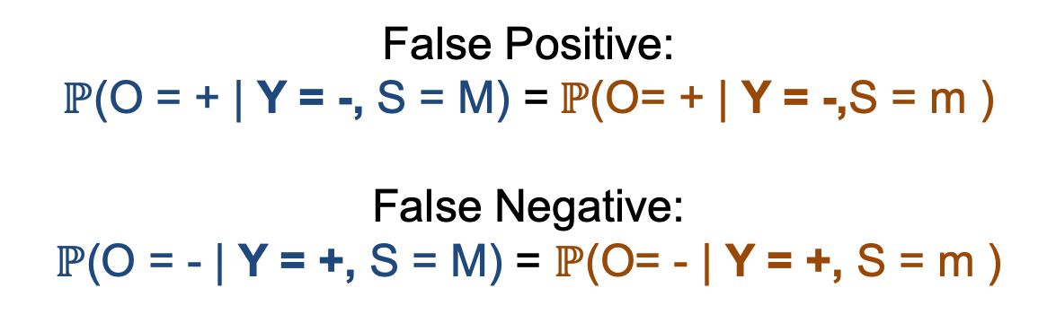
Predictive Parity (PP) a.k.a. Outcome Test or Test-fairness or Calibration
False Positive:
$\text{ℙ}$(O = + | Y = -, S = M) =$\text{ℙ}$(O= + | Y = -,S = m )
False Negative:
$\text{ℙ}$(O = - | Y = +, S = M) = $\text{ℙ}$(O= - | Y = +, S = m )
O is predicted outcome, {-, +} (e.g., loan application approved)
Y is actual outcome, {-, +}
S is a sensitive attribute, {m,M}
A is some other attribute

Slide 36
Predictive Parity (PP) a.k.a. Outcome Test or Test-fairness or Calibration
False Positive:
$\text{ℙ}$(O = + | Y = -, S = M) =$\text{ℙ}$(O= + | Y = -,S = m )
False Negative:
$\text{ℙ}$(O = - | Y = +, S = M) = $\text{ℙ}$(O= - | Y = +, S = m )
“The probability that the prediction is positive given that the true outcome is negative and the individual is majority is equal to the probability that the prediction is positive given that the true outcome is negative the individual is minority.”

Slide 37
Predictive Parity (PP) a.k.a. Outcome Test or Test-fairness or Calibration
False Positive:
$\text{ℙ}$(O = + | Y = -, S = M) =$\text{ℙ}$(O= + | Y = -,S = m )
False Negative:
$\text{ℙ}$(O = - | Y = +, S = M) = $\text{ℙ}$(O= - | Y = +, S = m )
“The probability that the prediction is positive given that the true outcome is negative and the individual is majority is equal to the probability that the prediction is positive given that the true outcome is negative the individual is minority.”
S ⊥ O|Y
“The sensitive attribute is statistically independent of the predictions, given the true values”

Slide 38
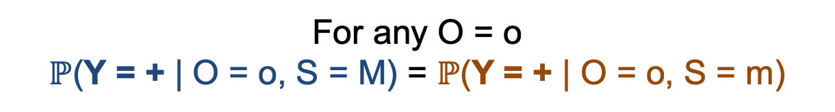
Equalized Odds (EO) a.k.a. Disparate Mistreatment
Just combine False Positive and False Negative into one condition!
For any O = o
$\text{ℙ}$(Y = + | O = o, S = M) = $\text{ℙ}$(Y = + | O = o, S = m)
“The probability that the true outcome is positive given any particular prediction and the individual is majority is equal to the probability that the true outcome is positive given any particular prediction and the individual is minority.”
S ⊥ Y |O
“The sensitive attribute is statistically independent of the true outcome, given the predictions”

Slide 39
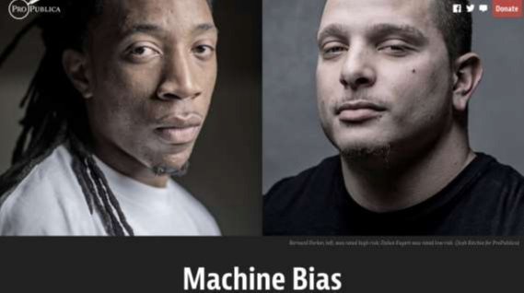
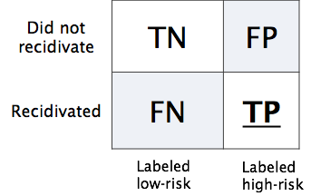
Some of these definitions are mutually exclusive!
Propublica, May 2016
Predictive Parity: same positive outcomes across groups, given predictions
Pr(high-risk | black, predicted low-risk) = Pr(high-risk | white, predicted low-risk)
Pr(high-risk | black, predicted high-risk) = Pr(high-risk | white, predicted high-risk)
Equalized Odds: same FP between groups
Pr(predicted high risk | black, low-risk) = Pr(predicted high-risk | white, low-risk)
These are mutually exclusive [Chouldechova 2017]
“21 different fairness metrics, implies hundreds of impossibility theorems”
[Narayanan 2018]
Notes:
the Equalized Odds and Predictive Parity are impossible to achieve simultaneously when prevalence of the two populations di ers, meaning Pr(Y = 1|S = 0) Pr(Y = 1|S = 1).

Slide 40
Takeaways
Lots of different notions of fairness
No “one size fits all definition”
Need to consider your application
All of these miss some broader issues – technical solutions aren’t enough

Slide 41
